Slide 1
Design Patterns
Instructor: Dr. Jagan Chidella
TA: Vamsi Krishna Myalapalli
Oracle Certified Professional JAVA SE 7 Programmer

Slide 2
Design Patterns
Creational
Structural
Behavioral
Way of Creating Objects
How classes and objects
can be composed,
to form larger structures
Interaction & responsibility
of objects
Singleton
Decorator
Iterator
Factory
Composite
Observer
Strategy

Slide 3
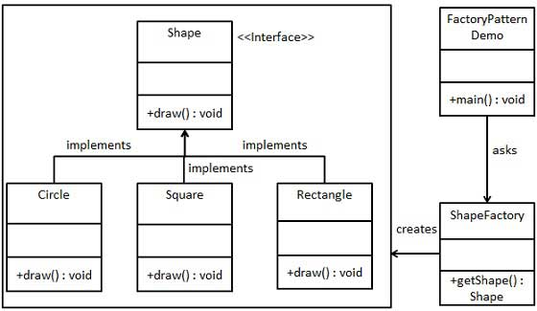
Factory Pattern
Define an interface or abstract class
for creating an object but let the subclasses
decide which class to instantiate
Notes:
In Factory pattern, we create object without exposing the creation logic to the client and refer to newly created object using a common interface.
Implementation:
We're going to create a Shape interface and concrete classes implementing the Shape interface. A factory class ShapeFactory is defined as a next step.
FactoryPatternDemo, our demo class will use ShapeFactory to get a Shapeobject.
It will pass information (CIRCLE / RECTANGLE / SQUARE) to ShapeFactory to get the type of object it needs.

Slide 4
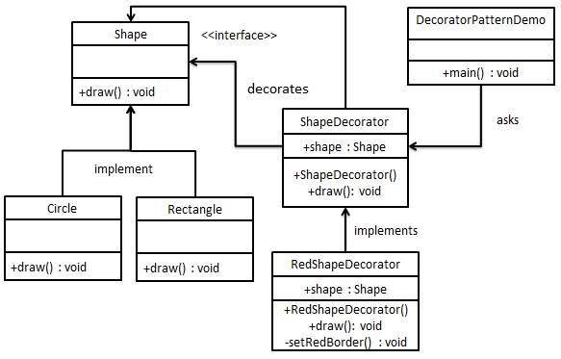
Decorator Pattern
Decorator pattern allows a user to add new functionality to an existing object without altering its structure.
Notes:
We're going to create a Shape interface and concrete classes implementing the Shape interface.
We will then create an abstract decorator class ShapeDecorator implementing the Shape interface and having Shape object as its instance variable.
RedShapeDecorator is concrete class implementing ShapeDecorator.
Application, our demo class will use RedShapeDecorator to decorate Shape objects.

Slide 5
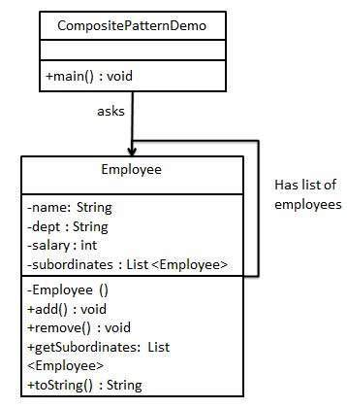
Composite Design Pattern
Composite pattern is used where we need to treat a group of objects in similar way as a single object.
Notes:
Composite pattern is used where we need to treat a group of objects in similar way as a single object. Composite pattern composes objects in term of a tree structure to represent part as well as whole hierarchy. This type of design pattern comes under structural pattern as this pattern creates a tree structure of group of objects.
This pattern creates a class that contains group of its own objects. This class provides ways to modify its group of same objects.
We are demonstrating use of composite pattern via following example in which we will show employees hierarchy of an organization.

Slide 6
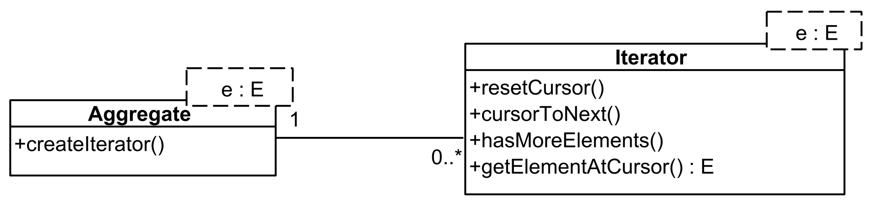
Iterator Design Pattern
Access the elements of a collection object in sequential manner without any need to know its underlying representation.

Slide 7
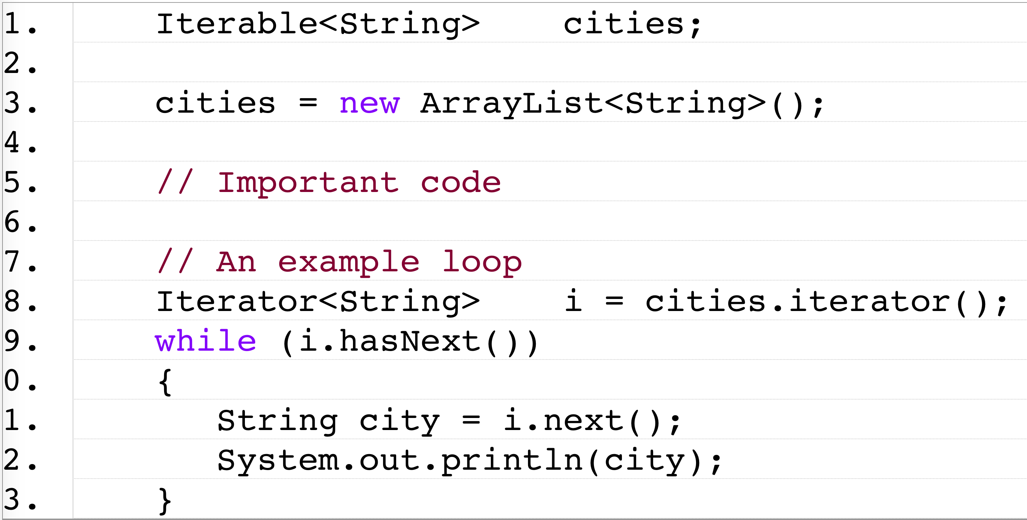
Iterator Design Pattern
Access the elements of a collection object in sequential manner without any need to know its underlying representation.

Slide 8
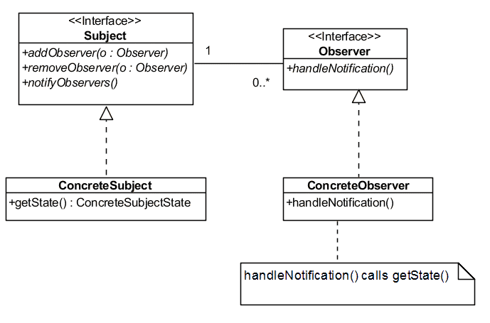
Observer Pattern
One-to-many relationship between objects such as if one object is modified, its dependent objects are to be notified automatically.

Slide 9
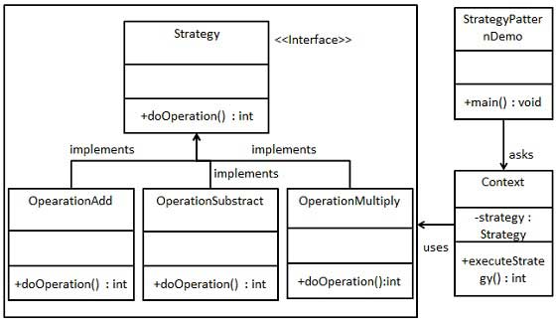
Strategy Pattern
A class behavior or its algorithm can be changed at run time. This type of design pattern comes under behavior pattern.

